Slide 1
ENZYMES
TYPES, MECHANISM OF ACTION, ENZYME STRATEGIES, FACTORS AFFECTING ENZYME ACTIVITY, ENZYME INHIBITION

Slide 2
INTRODUCTION
Enzymes are biological molecules (typically proteins) that significantly speed up the rate of the chemical reactions that take place within cells.
They are vital for life and serve a wide range of important functions in the body, such as aiding in digestion and metabolism
The substrate is a molecule upon which an enzyme acts. Enzymes catalyze chemical reactions involving the substrate(s).

Slide 3
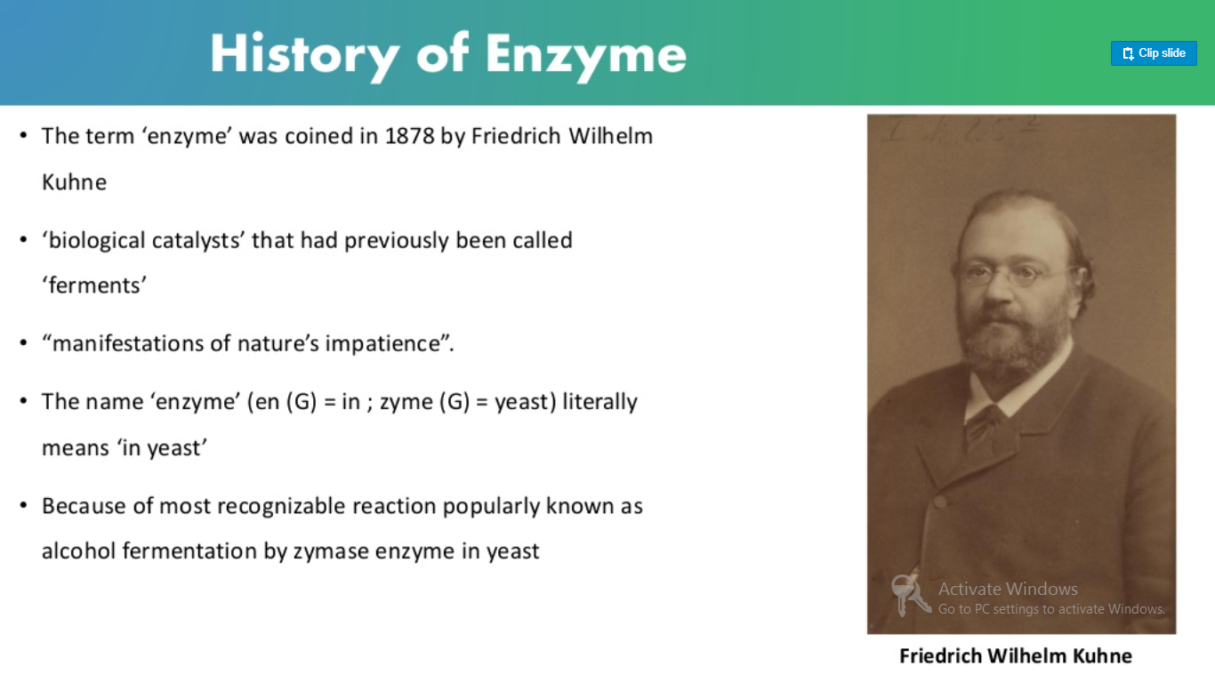

Slide 4
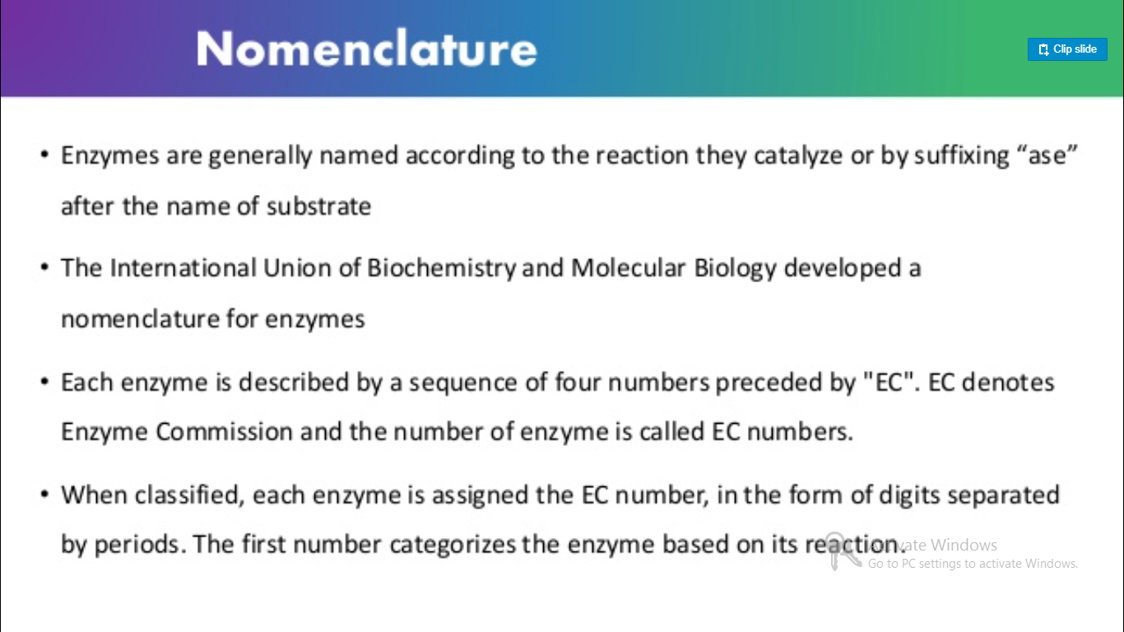

Slide 5
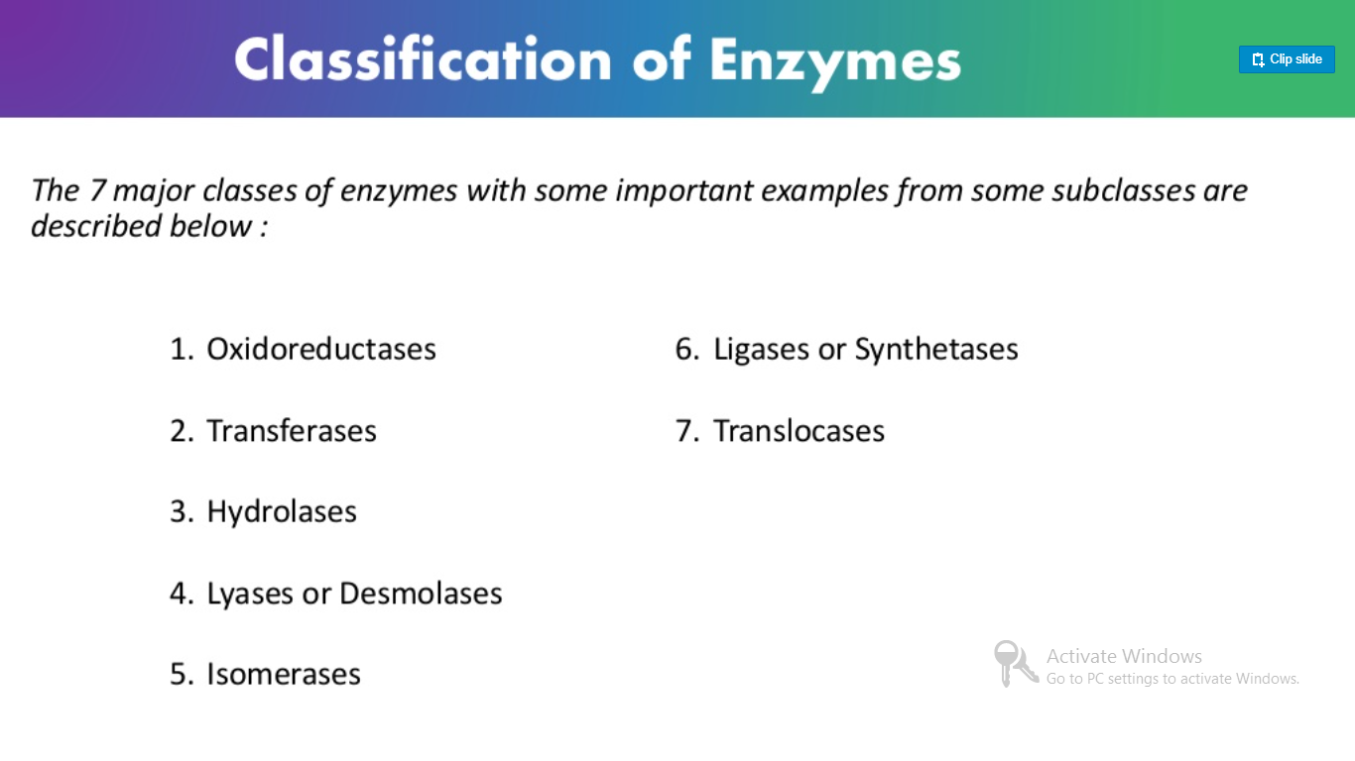

Slide 6
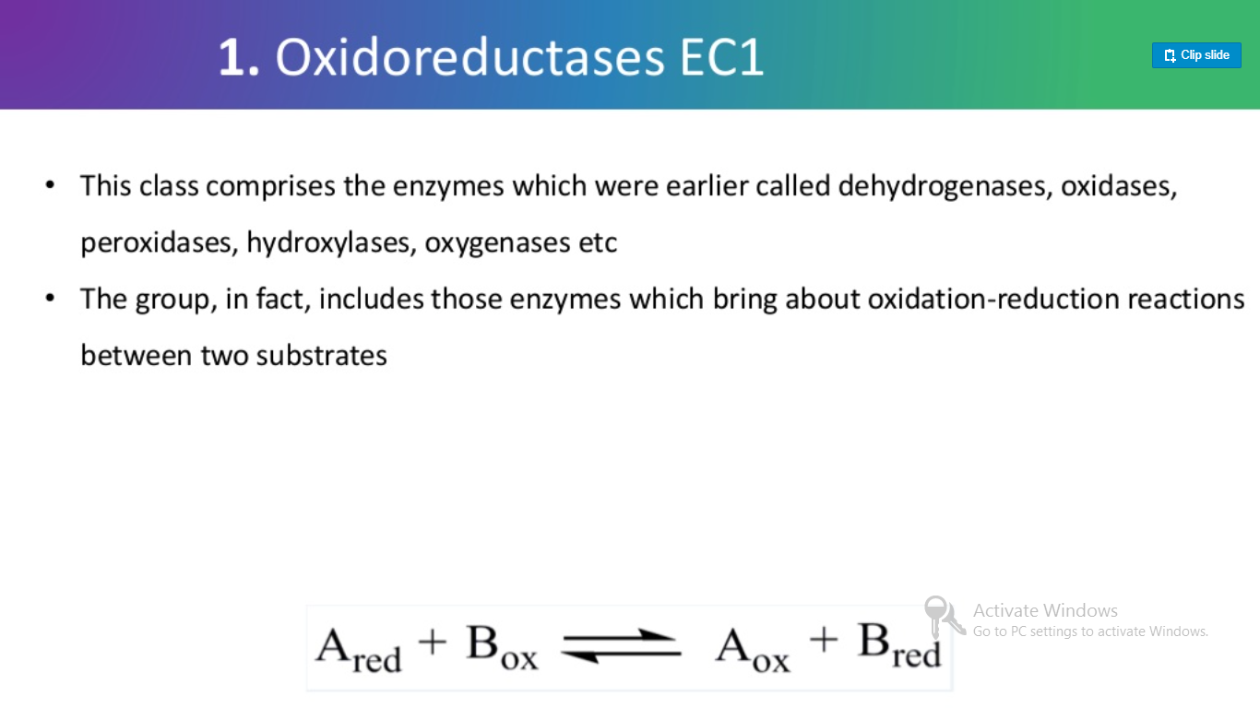
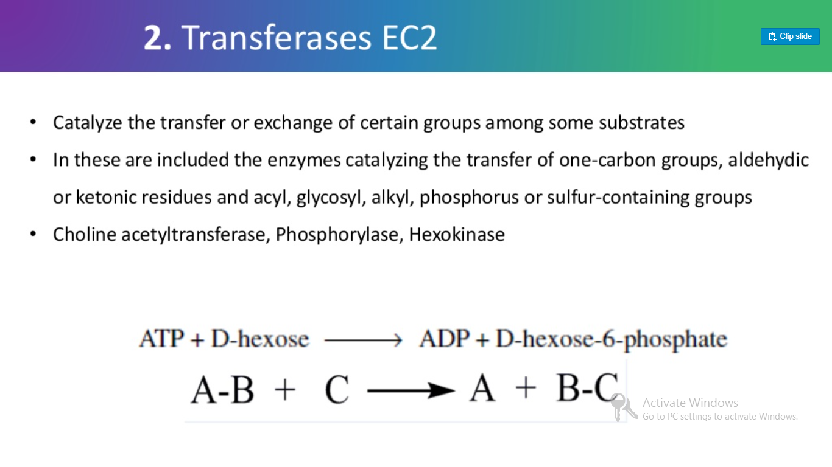
1. OXIDOREDUCTASE
2. TRANSFERASES

Slide 7
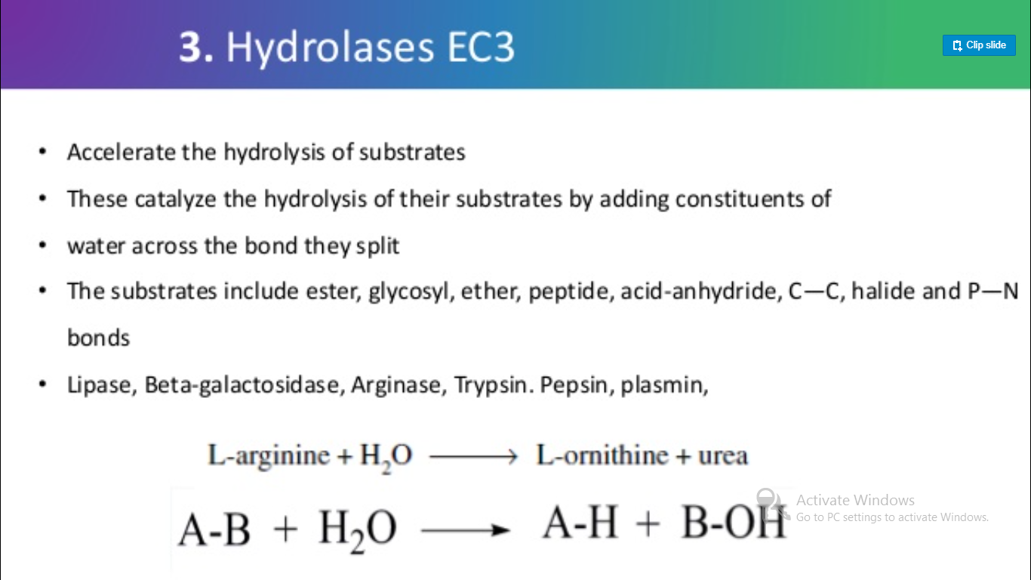
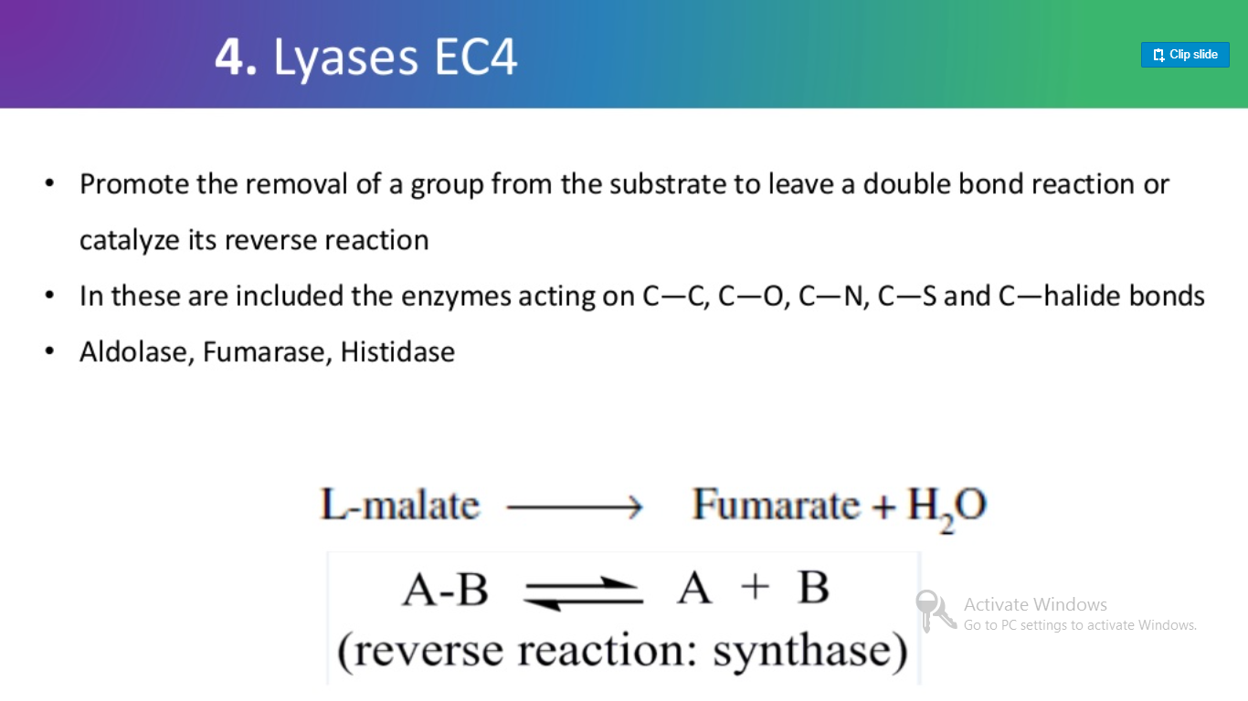
3. HYDROLASES
4. LYASES

Slide 8
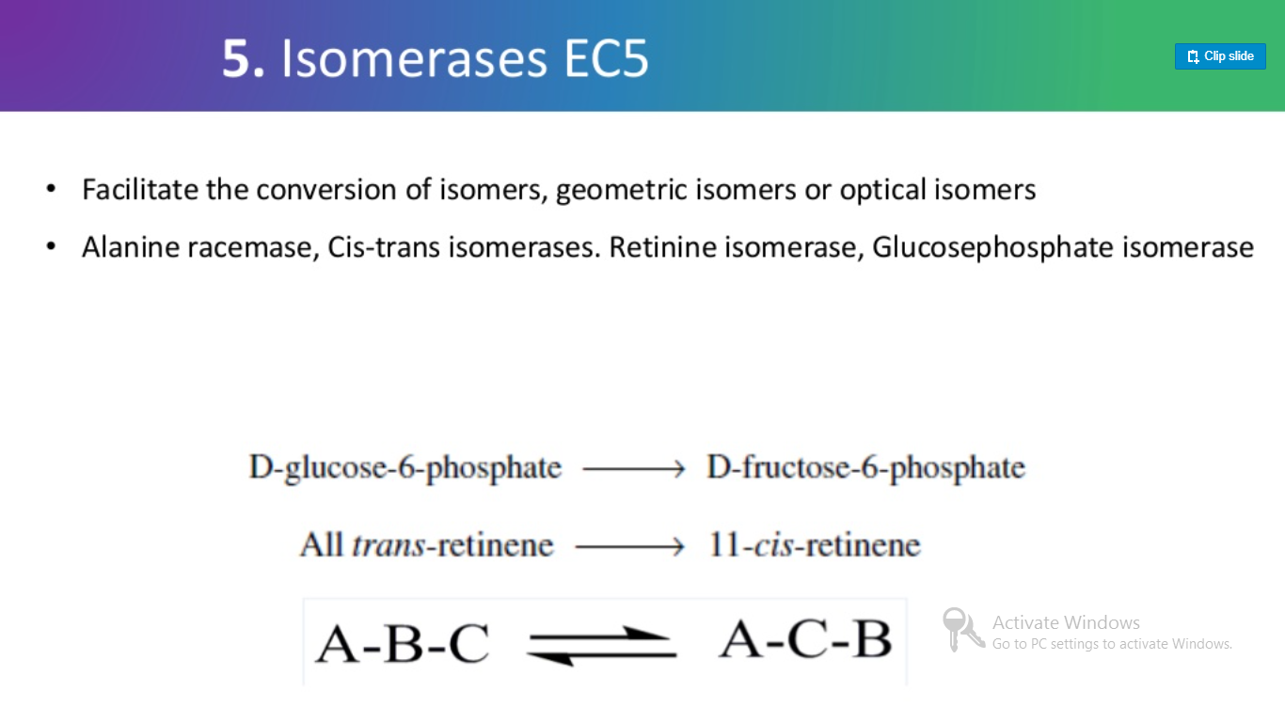
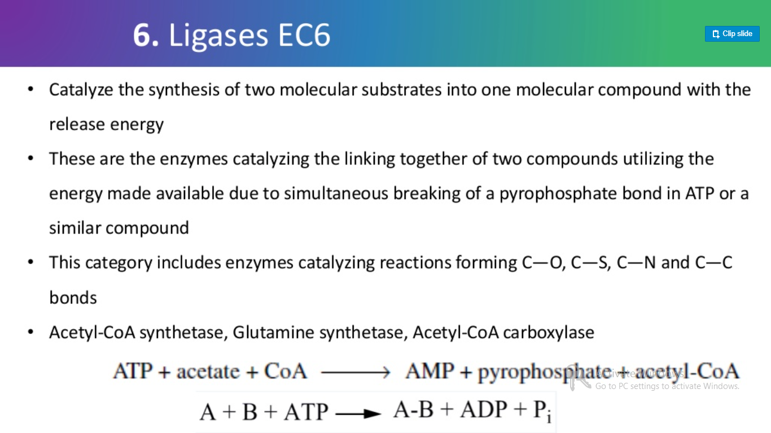
5. ISOMERASES
6. LIGASES

Slide 9
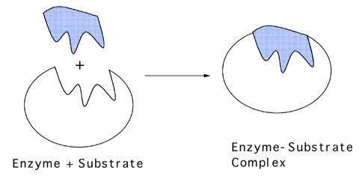
ENZYME- SUBSTRATE COMPLEX
Each enzyme need a specific substrate to perform its catalytic activity
An enzyme comprises smaller portion called active site to welcome its substrate.
During enzyme-catalyzed reactions, substrate binds to active site by means of hydrogen bonds or hydrophobic interactions or weak Van der waals forces
Consequently enzyme-substrate complex is formed.
Enzyme (E)+ Substrate (S) = Enzyme-Substrate or ES complex
ES complex formed is mostly unstable because bonds formed b/w enzyme and its substrate are temporary and bounded substrate will instantly transformed into product(s).
ES complex → Enzyme(E) + Products(P)

Slide 10
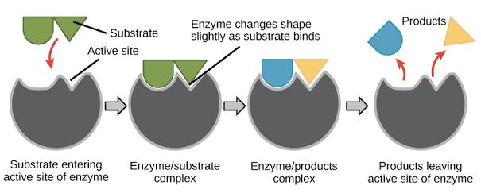

Slide 11
Mechanism of Enzyme action
The Lock-and-key Hypothesis – proposed by Emil Fishser
This model is based on lock key hypothesis- as specific key fits to specific lock
It states that the shape of the active Site of enzymes are exactly complementary to the shape of the substrate
When a substrate molecule collides with an enzyme and active Site shape is complementary to that of the substrate will fit into the active Site and it form an Enzyme-Substrate Complex
The enzyme will catalyse the reaction, and the products, together with the enzyme, will form an Enzyme-Product Complex
According to this model, it is possible for an enzyme to catalyse a reverse reaction.

Slide 12
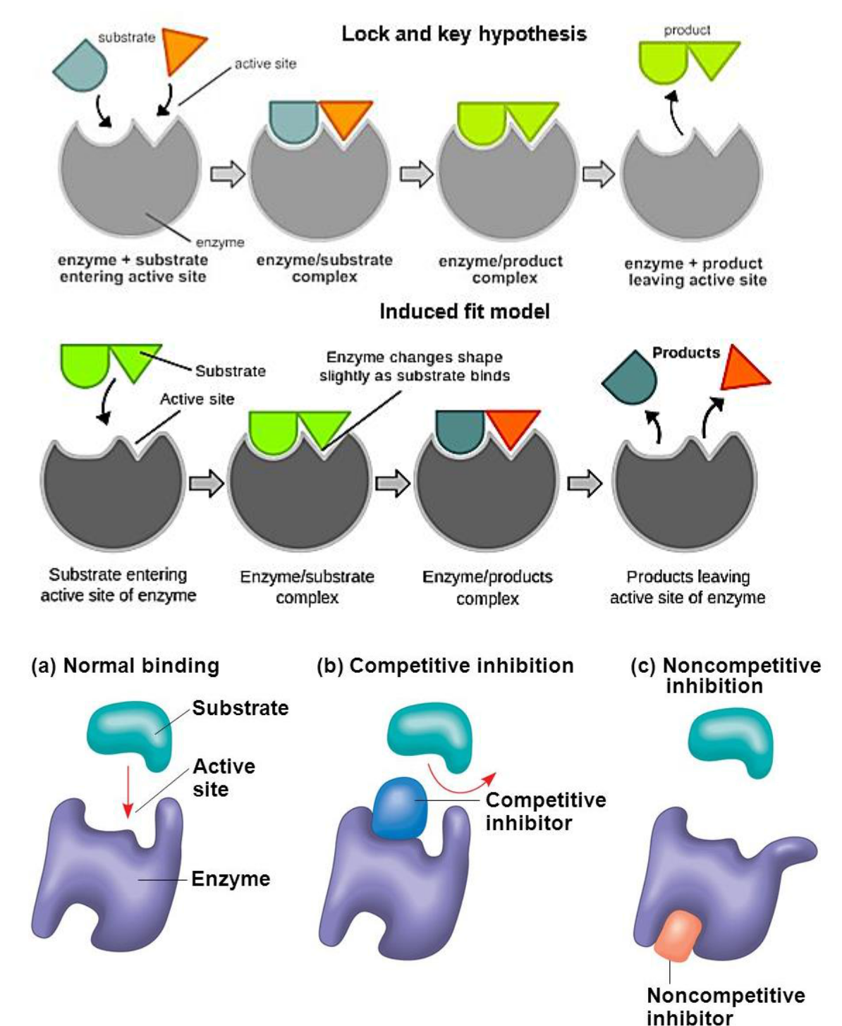

Slide 13
The Induced-Fit Hypothesis – Proposed by Koshland
A more recent model that is widely accepted as describing the way enzymes work is the Induced-Fit hypothesis
It states that the shape of active sites are not exactly complementary, but it changes its shape in presence of a specific substrate
When a substrate molecule collides with an enzyme, if its composition is specifically correct, the shape of the enzyme’s active site will change so that the substrate fits into it to form an enzyme-substrate complex
The reaction is then catalysed to form enzyme-product Complex

Slide 15
FACTORS INVOLVED IN ENZYME ACTIVITY
There are three factors which are involved in enzyme activity. They are as follows:
1. Environmental conditions
2. Cofactors and coenzymes
3. Enzyme inhibitors

Slide 16
1. ENVIRONMENTAL CONDITIONS
A. TEMPERATURE
Bioenzymes are active at 37°C
As, there is a rise in temperature,enzyme will be denature
Above 50 °C most of human enzymes will get denature
B. pH
Most enzymes are active at pH 6-8
When pH outside this range, the enzyme change its shape and get denatured
The optimal pH for most of the enzyme is 7
C. CONCENTRATION
The concentration of enzyme and substrate concentration have effect on the enzyme reaction
Increase in the substrate and enzyme concentration will ultimately increases the enzyme activity

Slide 17
2. Coenzymes and cofactors
Inorganic substances like (zinc, iron) are essential for the enzyme activity
eg: Iron is present in the quaternary structure of haemoglobin to transfer oxygen
3.ENZYME INHIBITORS
Compounds which convert the enzymes into inactive and thus adversely affect the rate of enzymatically catalyzed reaction are called as inhibitors. Such process is called as enzyme inhibition
There are two types of inhibition:
Competitive inhibition
Non-competitive inhibition

Slide 18
a) Competitive inhibition
A competitive inhibitor competes with the substrate at the active site by attaching to the active site
This type of competition occurs in the active site
The structure of the inhibitor closely resemble with that of the substrate
Thus it combines with the enzyme, forming an enzyme-inhibitor complex.
The inhibitor competes with the substrate to combine with the enzyme
Eg. Succinic dehydrogenase catalyzes the conversion of succinic acid to fumaric acid. Malonic acid acts as the inhibitor

Slide 19
b) Non- competitive Inhibition
A non-competitive inhibitor changes the shape of the active preventing the substrate from binding with active site of an enzyme
No competition occurs between the substrate and inhibitor
The inhibitor has little or no structural resemblance with the substrate and it binds with enzyme at a place other than the active site
Eg. Cyanide combines with the prosthetic group of cytochrome oxidase and inhibits the electron transport chain

Slide 20
APPLICATIONS OF ENZYMES
PROTEASE
This enzyme hydrolyse (breakdown) peptide bonds of proteins
Eg. Pepsin, Trypsin, chymotrypsin
RESTRICTION ENZYMES
This enzyme cuts DNA at specific recognition nucleotide sequences known as restriction sites
This enzyme also called as ‘molecular scissors’
Endonuclease break nucleotides at middle of the strand
Exonuclease breakdown the nucleotides at the end of the DNA strand

Slide 21
TYPES OF RESTRICTION ENZYMES
Restriction endonucleases are categorized into three groups namely: Type I, Type II, Type III.
Classification is based on their composition, enzyme co-factor, nature of target sequence
APPLICATIONS OF RESTRICTION ENZYME
Gene cloning
Protein expression experiments
Restriction enzymes are mostly used in biotechnology

Slide 22
THANK YOU

